Slide 1

Welcome
EIC EDGE – Week 2 Software Development Practice
Notes:
Mandatory
ACTION: Adjust title to fit your course.

Slide 2
Why study these subjects?
Being able to effectively apply your software development methodology in practice can be the difference between success and failure
Making judicious use of automated unit tests helps you practice “shift left” and high quality
Knowing how to troubleshoot issues with code as you develop helps you complete tasks and find and fix bugs
Understanding key deployment technologies like Docker and Kubernetes helps you deliver software faster
Understanding principles of good code review helps you contribute to overall team success

Slide 3
My pledge to you
I will...
Make this interactive
Ask you questions
Ensure everyone can speak
Use an on-screen timer
Notes:
Mandatory
Script: This is my pledge to you. I’d like to talk in particular about the third bullet. Sometimes in a class, an enthusiastic participant will want to speak out in every discussion, answer every question and so forth. I want to make sure all of you have the opportunity to be heard. So, if I haven’t heard from you in awhile, I may call on you or check in via chat, because I want to make sure everyone gets their questions answered. Also, I want to demonstrate the timer and confirm that everyone can see it. EggTimer is a good timer - https://e.ggtimer.com/

Slide 4
Objectives
At the end of this course, you will be able to:
Write automated unit tests in Python, measure code coverage as part of a TDD-strategy, and troubleshoot issues encountered when building Python apps
Use Docker to containerize workloads, enabling consistent delivery of high-quality software regardless of deployment target
Contribute to team productivity by effectively reviewing and providing feedback on code changes
Notes:
Mandatory
ACTION: Adjust objectives to fit your course.
Use measurable objectives that start with action verbs such as: describe, define, identify, assess, demonstrate, use, utilize. https://elearningindustry.com/writing-learning-objectives-for-elearning-what-elearning-professionals-should-know

Slide 5
Agenda
Day One
Python Refresh, Part 1
Day Two
Python Refresh, Part 2
Unit Testing/Debugging in Python, Part 1
Day Three
Unit Testing/Debugging in Python, Part 2

Slide 6
Agenda
Day Four
Docker & Kubernetes, Part 1
Day Five
Docker & Kubernetes, Part 2
Notes:
- Ask about programming language most familiar with

Slide 7
How we’re going to work together
Lab work will take place in individual workspaces – isolated, browser-based virtual machines
Classroom labs may include individual work as well as group discussion and work
I welcome being interrupted – if you need more info, or clarification, or anything else, just break in and ask. I am here to help you.
Notes:
Mandatory
ACTION: Adjust bullets as per your course.
In this section, discuss the structure of the course—exercises, labs, etc.
Also, discuss any resources students will be using.

Slide 8
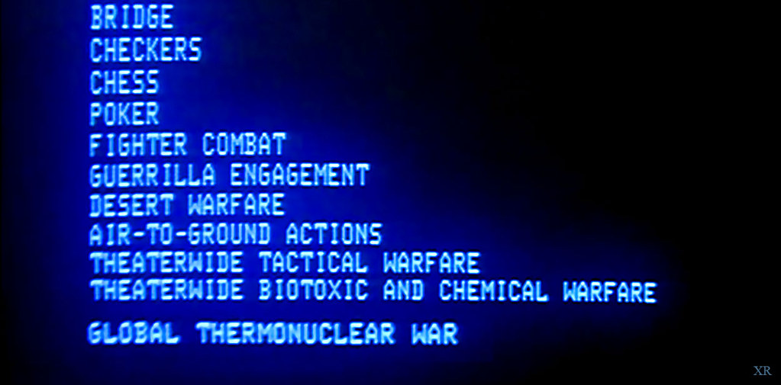
Would you like to play a game?
To make it interesting, let’s add a competition factor to our time together ☺
For questions posed to the larger group, 1 point will be awarded for each answer provided by a participant
2 points will be awarded for acting as a spokesperson for a breakout room during one of our group discussions
There will be a rubric provided for the capstone (targeted for week 4) which will define a points breakdown for the implemented solution

Slide 9
Python Refresh

Slide 10
Data Types, Operators, and Variables
https://github.com/KernelGamut32/intermediate-python/blob/main/01%20Data%20Types%2C%20Operators%2C%20and%20Variables.ipynb

Slide 11
Conditionals
https://github.com/KernelGamut32/intermediate-python/blob/main/02%20Conditionals.ipynb

Slide 12
Functions
https://github.com/KernelGamut32/intermediate-python/blob/main/03%20Functions.ipynb

Slide 13
Looping
https://github.com/KernelGamut32/intermediate-python/blob/main/04%20Looping.ipynb

Slide 14
Additional Datatypes
https://github.com/KernelGamut32/intermediate-python/blob/main/05%20Additional%20Datatypes.ipynb

Slide 15
Files and Regular Expressions
https://github.com/KernelGamut32/intermediate-python/blob/main/06%20Files%20and%20Regular%20Expressions.ipynb

Slide 16
Modules
https://github.com/KernelGamut32/intermediate-python/blob/main/07%20Modules.ipynb

Slide 17
Object-Oriented Programming
https://github.com/KernelGamut32/intermediate-python/blob/main/08%20Object-Oriented%20Programming.ipynb

Slide 18
Unit Testing/Debugging in Python

Slide 19






Common Components of a Unit Testing Framework
Base class defined in the framework from which test classes derive
Fixtures that run before and after blocks of test code
Assertions – the automated evaluation executed against our code to verify
Test suite that collects a group of related tests to be executed together
Runner built-in to the framework that executes the tests
Reporting mechanism that can provide results in different formats
Notes:
Several frameworks supported – unittest, pytest, nose/nose2

Slide 20
Arrange, Act, Assert (AAA)
Pattern used in unit testing to help us organize our tests, improve readability, and ensure good practice when building tests.

Slide 21

Arrange
Execute any required set up in preparation for running one or more tests
Can include creation of objects that will be needed during test execution
Might also include set up of mocks (to ensure test isolation) or creation of test data (if directly testing data access methods)

Slide 22

Act
Exercising the code under test
Executing any methods or actions on the class structures you want to verify
Representative of how code might be called in production
Should not include an extensive amount of code – otherwise, could be a “smell” that you’re testing too much in a given test case

Slide 23

Assert
Does the result match my expectation for how the code under test should function?
Determines pass/fail for the test
Often tests will have only a single assert
Can include multiple asserts, but the asserts should all relate cohesively to the same function/test case/object

Slide 24
Writing Unit Tests in unittest
Notes:
INSTRUCTOR NOTES:
REVIEWER COMMENTS:

Slide 25
unittest Framework
Included in Python standard library
Provides a framework for building and running unit tests against Python code (functions, classes, etc.)
A Python file houses code that will be used to automate the testing

Slide 26
unittest Framework
Test code imports unittest and module under test
We write Python methods to exercise our business logic and verify expected outputs

Slide 27

unittest Framework - Keys
Our test class derives from unittest.TestCase
Several versions of “assert” method provide robust validation
Usually, test code and code under test kept in separate files (and potentially in separate folders)
Test fixtures promote reuse and help keep our code clean
unittest offers multiple options for specifying which of a set of tests you want to execute

Slide 28
unittest Framework
unittest includes multiple “assert” methods for checking different kinds of results (expected vs. actual)
Can exercise tests through unittest framework
Results will indicate success (or failure)

Slide 29
unittest Framework
Assert methods include (among others):
assertEqual/assertNotEqual
assertTrue/assertFalse
assertIn/assertNotIn

Slide 30
LAB:
Review the documentation on the different types of assert methods available with unittest (at https://docs.python.org/3/library/unittest.html#assert-methods).
Create a test module and include tests to successfully exercise each type of assert using simple expressions. Investigate/drilldown into documentation on each type of assert as needed to understand its usage.
unittest Assert Methods

Slide 31
unittest Framework – Test Fixtures
Rather than repeat common logic across tests, unittest provides a couple of options for capturing:
setUp
tearDown
Includes a few different forms

Slide 32
unittest Framework – Test Fixtures
setUpModule
setUpClass
setUp
Class
Test
Module
tearDown
tearDownClass
tearDownModule

Slide 33
unittest Framework – Test Fixtures
setUpModule
Called once before anything else in the module
setUpClass
setUp
Class
Test
Module
tearDown
tearDownClass
tearDownModule

Slide 34
unittest Framework – Test Fixtures
setUpModule
setUpClass
Called once before any test executed in the class
setUp
Class
Test
Module
tearDown
tearDownClass
tearDownModule
Notes:
Requires decoration as a class method (@classmethod) – called on class vs instance of class (like static)

Slide 35
unittest Framework – Test Fixtures
setUpModule
setUpClass
setUp
Called before each test is executed (multiple)
Class
Test
Module
tearDown
tearDownClass
tearDownModule

Slide 36
unittest Framework – Test Fixtures
setUpModule
setUpClass
setUp
Class
Test
Module
Called after each test is executed (multiple)
tearDown
tearDownClass
tearDownModule

Slide 37
unittest Framework – Test Fixtures
setUpModule
setUpClass
setUp
Class
Test
Module
tearDown
Called once after all tests executed (if setUpClass successful)
tearDownClass
tearDownModule
Notes:
Requires decoration as a class method (@classmethod) – called on class vs instance of class (like static)

Slide 38
unittest Framework – Test Fixtures
setUpModule
setUpClass
setUp
Class
Test
Module
tearDown
tearDownClass
Called once after everything else in the module
tearDownModule

Slide 39
LAB:
Review the documentation on the different types of test fixture methods available with unittest (at https://docs.python.org/3/library/unittest.html#organizing-test-code and https://docs.python.org/3/library/unittest.html#setupclass-and-teardownclass).
Create a test module and include tests to practice utilization of setUp(), tearDown(), setUpClass(), and tearDownClass(). You can use simple print statements to experiment with the different test fixture methods and their timings.
unittest Test Fixtures

Slide 40
unittest Framework – Managing Test Execution
Options
As an executable module
Using unittest to execute entire module
Using unittest to execute single test class (or individual test cases)
Create a test package

Slide 41
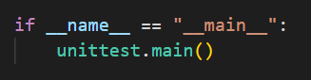
unittest Framework – Managing Test Execution
As an executable module
Add the following to your test module:
Can execute all tests in module using `python -m <test_module_name>` or `python <test_module_name>.py`

Slide 42
unittest Framework – Managing Test Execution
Using unittest to execute entire module
X
Does not require:
Can execute all tests in module using `python -m unittest <test_module_name>` or `python -m unittest <test_module_name>.py`

Slide 43
unittest Framework – Managing Test Execution
Using unittest to execute single test class (or individual test cases)
X
Does not require:
Can execute a specific test class using `python -m unittest <test_module_name>.<test_class_name>`. Can execute a specific test case using `python -m unittest <test_module_name>.<test_class_name>.<test_case_name>`

Slide 44
unittest Framework – Managing Test Execution
Create a test package
X
Does not require:
Capture test modules under a folder and add a `__init__.py` package initializer with simple contents:
From root folder containing package, can execute using variants of `python -m unittest <package_name>.<test_module_name>[.<test_class_name>.<test_case_name>]`
Notes:
__init__.py is what really defines a Python package as a package

Slide 45

unittest Framework – Test Discovery
unittest also supports a “discovery” mode
Quickly execute all tests in the project directory and its subdirectories
Available using `python -m unittest discover` or simply `python -m unittest`
All test files must be modules or packages importable from top-level directory
By default, starts from current directory
By default, searches for test*.py pattern in filenames to identify tests to be executed

Slide 46

unittest Framework – Skipping Tests
While permanently skipping tests can be a “smell”, unittest offers options for temporarily skipping:
@unittest.skip() decorator
@unittest.skipIf() decorator
@unittest.skipUnless() decorator
self.skipTest method – call within test to initiate a skip

Slide 47
LAB:
Create a test package containing multiple test modules with tests for simple expressions/asserts. Experiment with the various ways you can execute different combinations of tests.
Review the documentation on the different types of basic skip options available with unittest (at https://docs.python.org/3/library/unittest.html#skipping-tests-and-expected-failures). Create a test module and include tests to practice utilization of each of the basic types (skip, skipIf, skipUnless, and self.skipTest).
unittest – Managing Test Execution
Notes:
Can include a brief discussion of expectedFailure decorator – but encourage that participants fix the test (or delete) rather than allowing to go on failing for an extended period of time

Slide 48

unittest Framework – Managing Test Failures
Sometimes, our tests fail
Any Exception raised in a test case causes that test case to fail
The assert methods raise exceptions if the expected result does not occur (i.e., assertEqual determines not equal)
For certain edge or exception cases, we may expect an Exception to be raised
In those cases, an Exception is success – tests that our code correctly handles bogus data
assertRaises is provided by the unittest framework for this purpose

Slide 49
LAB:
Build a set of Python classes and unit tests as described in the lab detail at https://github.com/KernelGamut32/capital_group_edge_la_public/tree/main/labs/week02/unittest-python-movie.
unittest – Testing Classes

Slide 50
LAB:
Build a set of Python classes and unit tests as described in the lab detail at https://github.com/KernelGamut32/capital_group_edge_la_public/tree/main/labs/week02/unittest-python-wordcount.
unittest – Testing Classes

Slide 51
Mocking – Testing Components in Isolation

Slide 52

Mocking / Test Doubles
We use mocking/test doubles:
To help isolate our testing to focused areas of code
To manage dependencies and help control testing against them
To force special cases that exercise specific code flows
To bring stability and consistency to our tests
Helps make the “unit” in unit testing possible
Notes:
Often use the term “mocking” but the concept is more nuanced
We want to be able to setup conditions that allow us to test in isolation so we can ensure maximum coverage of our code with our tests

Slide 53
Mocking / Test Doubles
Dummies
Fakes
Stubs
Spies
Mocks
Notes:
Maintainable - readable

Slide 54

Dummies
Simplest form of test double
No real functionality – mostly a placeholder
When dependency exists but is not needed for the test
Create and use an empty or straightforward copy
Returns meaningless value on every call

Slide 55

Stubs
Same response regardless of parameters passed
Used to test different paths through code
Allows you to control the value of the dependency
Can also use to force an exception
Create a copy of the dependency and return same value

Slide 56

Spies
Can return a value like a stub
Also provides info about how called
Verify member call with specific parameter values
Verify member call a specific number of times
Verify whether member called or not
Helpful with testing at third party boundaries
Helpful with managing side effects of dependencies

Slide 57

Mocks
Programmable spies
Can return a set value like a spy
Difference is ability to setup test data in the double
Provides additional flexibility - can code the setup
Still only returns set value but it’s the value coded
Trade-off – requires setup work

Slide 58

Fakes
Most powerful type of test double
Acts like the class/component it’s doubling for
Double that’s more sophisticated (but still controlled)
Useful for managing downstream dependencies
Gating database connections
Gating web service calls
File operations
Can appear to integrate but control results
Notes:
Classic example – fake repository that provides hard-coded values instead of requiring a hit to the database

Slide 59
DEMO:
unittest – Mocking
Notes:
Walkthrough https://github.com/KernelGamut32/capital_group_edge_la_public/tree/main/demos/week02/mocks

Slide 60

Coverage

Slide 61
Coverage
Coverage in unit testing measures the % of your code under test that is exercised by a unit test
Coverage value can range between 0 and 100 %
Question: What is the right target % of coverage to aim for?

Slide 62
Coverage
coverage.py can be used to measure test coverage in your Python app
Install using pip (pip install coverage)
Use coverage run to measure
For unittest, use coverage run -m unittest <target>

Slide 63
Coverage – Measuring Results
Use coverage report to report coverage results
Alternatively, coverage html can be used to view coverage results in a more user-friendly manner

Slide 64
LAB:
Walk through the notebook (including code examples and exercises) at https://github.com/KernelGamut32/intermediate-python/blob/main/15%20Testing%20%2B%20TDD%20%2B%20Mocking.ipynb.
unittest – TDD and Mocking

Slide 65
LAB:
Build a set of Python classes and unit tests as described in the lab detail at https://github.com/KernelGamut32/capital_group_edge_la_public/tree/main/labs/week02/unittest-python-mocking.
unittest – TDD and Mocking

Slide 66
Docker & Kubernetes

Slide 67

Why Containerization?
Abstracts away the code implementation so you can deploy in a platform-agnostic manner, writing in the language of your choice
Aligns strongly with the principles and practices of DevOps
Helps leverage the power of the cloud
Speeds up important non-coding activities (infrastructure spin-up, testing, CI/CD tasks, DevSecOps, code quality checks, etc.
Helps breed consistency vs. “snowflake”

Slide 68


What Do We Mean by Application Hosting?
Target infrastructure and runtime platform used for deployment and execution
Can include compute (CPU and server resources), storage, network, data, and operating system

Slide 69

What Are the Hosting Options with Cloud?
IaaS (Infrastructure-as-a-Service)
PaaS (Platform-as-a-Service)
Serverless / FaaS (Functions-as-a-Service)
SaaS (Software-as-a-Service)
Containers
Notes:
We’ll discuss the other Cloud options more in Week 3

Slide 70

Containers
Form of virtualization at the app packaging level (like virtual machines at the server level)
Isolated from one another at the OS process layer (vs VM’s which are isolated at the hardware abstraction layer)
Images represent the packaging up of an application and its dependencies as a complete, deployable unit of execution (code, runtime and configuration)
Notes:
What are virtual machines? Virtual (vs. physical) computers built using images that support independent execution of and interaction with an instance built from the image and running against a “slice” of the physical host’s resources. Multiple VM instances can be run on the same physical host at the same time and are managed by a program called a hypervisor.
Containers are isolated from one another at the OS process layer (vs VM’s which are isolated at the hardware abstraction layer)

Slide 71
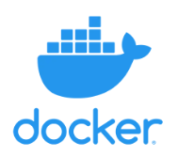

Containers
A platform (e.g., Docker) running on a system can be used to dynamically create containers (executable instances of the app) from the defined image
Typically, much, much smaller than a VM which makes them lightweight, quickly deployable and quick to “boot up”
An orchestration engine (e.g., Kubernetes) might be used to coordinate multiple instances of the same container (or a “pod” of containers) to enable the servicing of more concurrent requests (scalability)

Slide 72
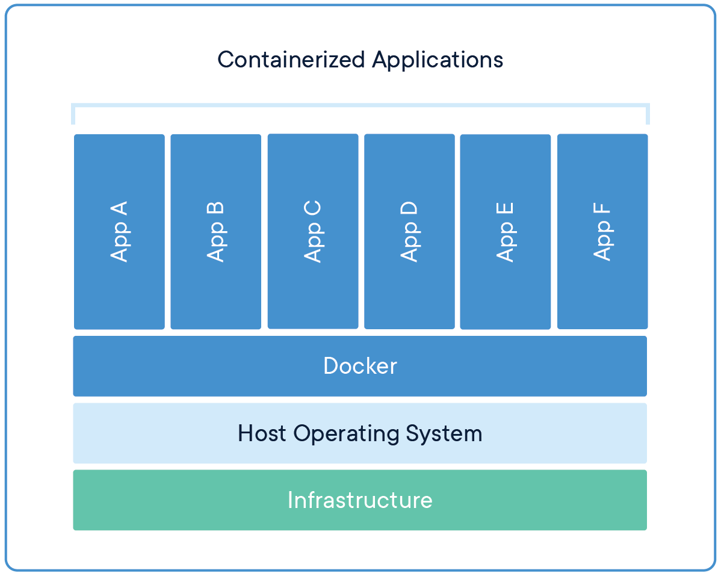
Containers

Slide 73




What are Microservices?
An architectural style in which a distributed application is created as a collection of services that are:
The Microservices architecture enables the continuous deployment and delivery of large, complex distributed applications
Highly maintainable and testable
Loosely coupled
Independently deployable (by extension, independently scalable)
Domain centric and organized around business capabilities

Slide 74

What is a Monolith?
Typical enterprise application
Large codebases
Set technology stack
Highly coupled elements
Whole system affected by failures
Scaling requires the duplication of the entire app
Minor changes often require full rebuild

Slide 75
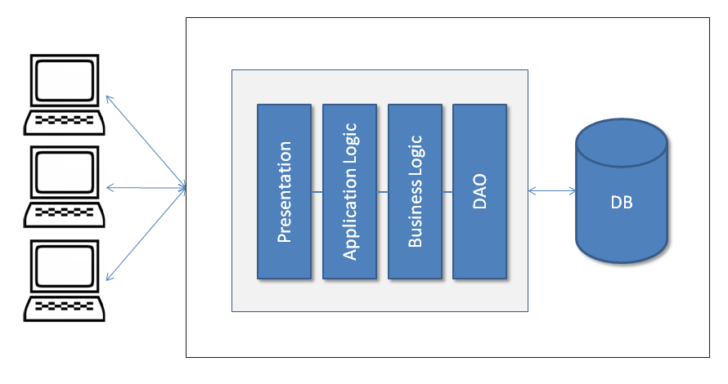
Monolithic Architecture Example

Slide 76
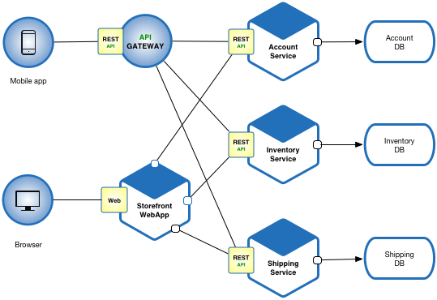
Example Microservices Architecture

Slide 77

Microservices – Benefits vs. Costs
Benefits:
Enables work in parallel
Promotes organization according to business domain
Advantages from isolation
Flexible in terms of deployment and scale
Flexible in terms of technology

Slide 78

Microservices – Benefits vs. Costs
Costs:
Requires a different way of thinking
Complexity moves to the integration layer
Organization needs to be able to support re-org according to business domain (instead of technology domain)
With an increased reliance on the network, you may encounter latency and failures at the network layer
Transactions must be handled differently (across service boundaries)
Notes:
Mention Conway’s Law
Talk about new customer operation with initial deposit – those operations need to happen transactionally

Slide 79
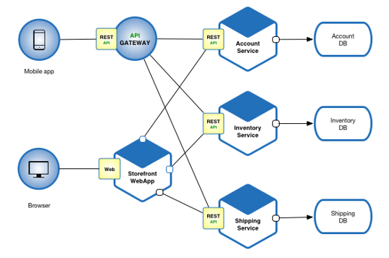
Microservices & Containers
Microservices – with their smaller size, independently-deployable and independently-scalable profile, and encapsulated business domain boundary – are a great fit for containers
Using Kubernetes, sophisticated systems of integrated microservices can be built, tested and deployed
Leveraging the scheduling and scalability benefits of Kubernetes can help an organization target scaling across a complex workflow in very granular ways
This helps with cost management as you can toggle individual parts of the system for optimized performance

Slide 80

Microservices & the Cloud
Microservices have broad support across multiple Cloud providers
One option includes standing up VM’s (IaaS) and installing / managing a Kubernetes cluster on those machines or
Another option includes leveraging a managed service (PaaS) provided by the CSP
Microservices are a great option for the Cloud because the elastic scalability provided by the Cloud infrastructure can directly support the independent scalability needed with a microservices architecture

Slide 81
Microservices Summary
Applications that can
Efficiently scale
Are flexible
Are high performance
These apps are powered by multiple services, working in concert
Each service is small and has a single focus
We use a lightweight communication mechanism to coordinate the overall system
This ends up giving us a technology agnostic API

Slide 82
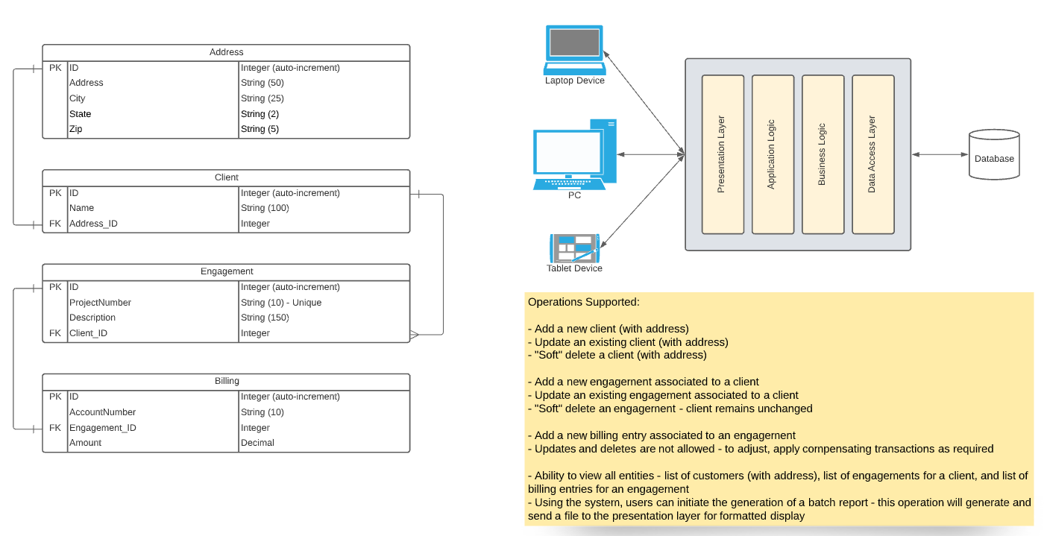
Use Case Discussion – Monolith to Microservices

Slide 83
Group Discussion:
In your assigned breakout rooms, using the architecture diagram for current state of the client engagement system (on the previous slide) and using the information on the previous set of slides on containerization and microservices, discuss the following as a team:
Where might you apply containerization in the implementation of an application rewrite?
What are some ways you could apply the microservices pattern as part of an application rewrite?
What are some specific benefits you might offer to justify the containerization and microservices investment?
What are some specific caveats or potential challenges that you would want to help the project team and business keep in mind with moving in this direction architecturally?
Nominate someone from your team to share the results of your team’s discussion.
Microservices

Slide 84
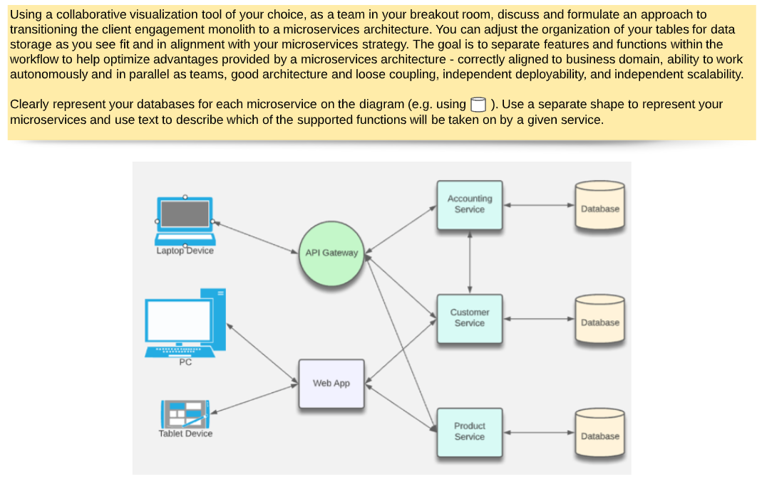
Use Case Discussion – Exercise

Slide 85

Modern Approaches to Application Development
Leverage the cloud
Abstract away as much of the non-code elements as possible
Use the tools that arise from DevOps (automation, feedback, etc.)
Integrate testing and code quality checks early (“Shift Left”)

Slide 86
Design Approaches to Modern Applications
Decompose when possible
Embrace Failure
Separate the language from the function of the code

Slide 87

Infrastructure as Code (IaC)
Declarative vs. Imperative coding
Drawbacks of declarative infrastructure
Impact of IaC on the dev process, on testing, and on deployment

Slide 88
What is Docker?
Built around the concept of images & containers
Also, supports composition of a set of containers to be deployed together
For example, application code + network components + database components

Slide 89
What is Docker?
Utilizes principles of “immutable infrastructure”
Complete application environments torn down and recreated as needed
Helps to minimize infrastructure “drift” and environment inconsistencies

Slide 90
The Dockerfile
Tells Docker what to do in creating an image for your application
The commands are all things you could do from the CLI
Used by the docker “build” command
Docker build uses this file and a “context” – a set of files at a specified location – to make your image

Slide 91
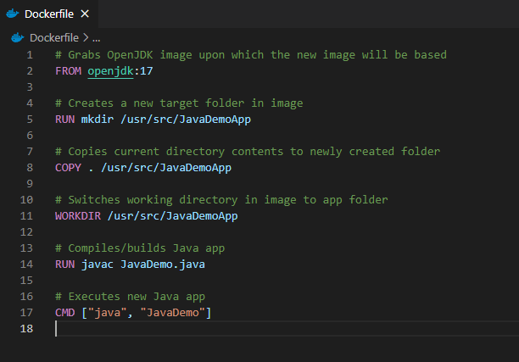
Dockerfile example
The following creates an image for building/running Java app in container
See https://github.com/KernelGamut32/dockerlab-repo-sample for sample

Slide 92
Docker Images
Represent templates defining an application environment
New instances of the application can be created from the image
These instances are called containers

Slide 93
Docker Images
Images are defined via a Dockerfile definition
Support layers for building up the environment in stages
Fully defines the application, including all components required to support

Slide 94
Docker Images
Those components can include:
Runtime
Development framework
Source code
Executable instructions for container startup

Slide 95
Docker Images
Start with a base that gives your app a place to live
Needed OS/runtimes/dB server applications, etc.
Examples:
nginx
Node
MySQL
Apache HTTP Server
IIS with .NET Runtimes

Slide 96
Docker Hub
Centralized registry for image storage & sharing
Can signup for an account – user accounts offer both free and pro versions
Also, supports organizations for grouping of multiple team members

Slide 97
Docker Hub
Accessible at https://hub.docker.com
Search feature enables search for image by technology or keyword
Image detail displays available tags and image variants

Slide 98
Docker Hub
May also include examples of usage
Pro account supports image scanning for security vulnerabilities
Can be useful for image reuse and image sharing across a dev team
There are other registry types – including private registries

Slide 99
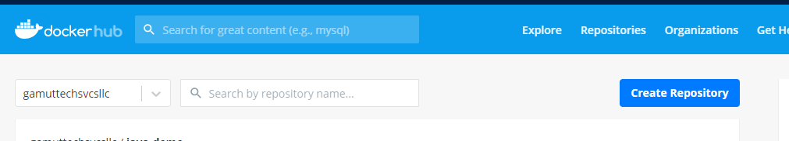
Docker Hub

Slide 100
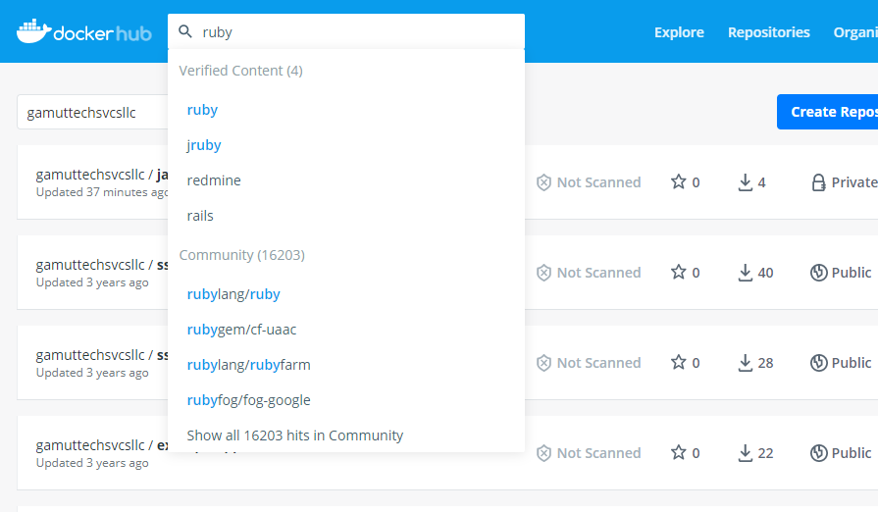
Docker Hub

Slide 101
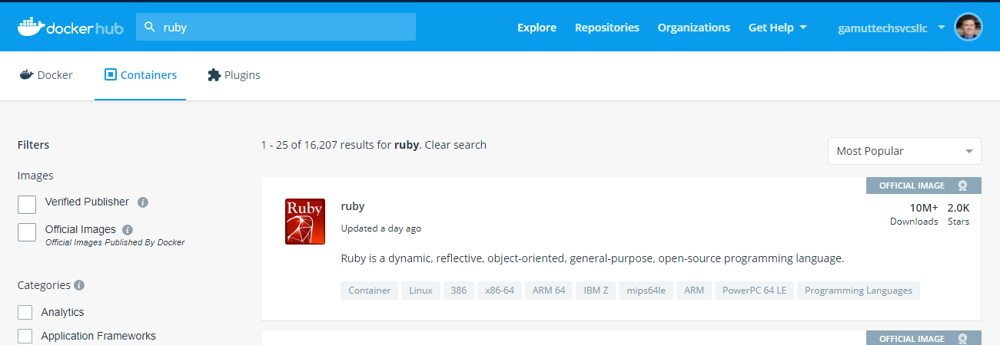
Docker Hub

Slide 102
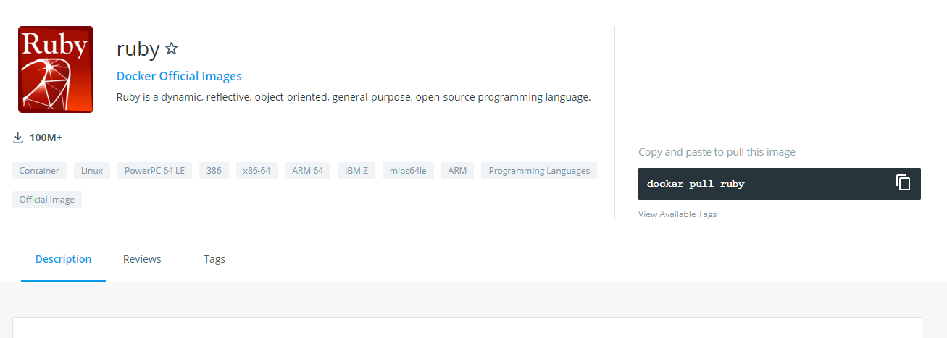
Docker Hub

Slide 103
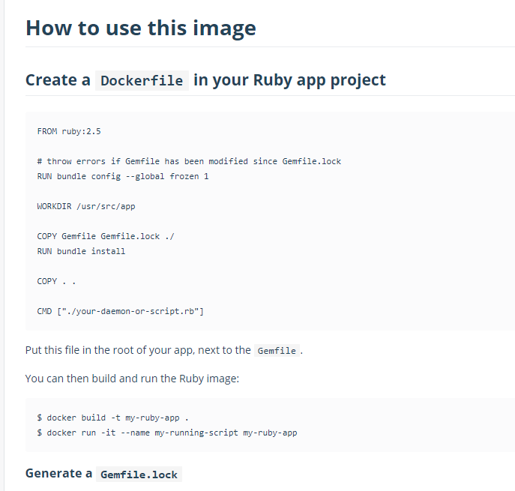
Docker Hub

Slide 104
Building The Image
To build the image from Dockerfile use docker build
docker build -t <tag name> <path to Dockerfile>
For example, docker build -t java-demo .
Builds image from Dockerfile in current folder (.) with tag name “java-demo”

Slide 105
Building The Image
For tag name, can include optional detail:
Docker ID in Docker Hub for eventual push to image registry
Version identifier for tag – defaults to “latest” if excluded
For example, docker build -t <docker ID>/<tag name>:<version> .

Slide 106
Docker Review Questions
What is the immediate result of a Docker build?
A – Container
B – Image
C - Cluster

Slide 107
Docker Review Questions
What do we use to create a Docker image?
A – Dockerfile
B – Docker Image
C - Dockerhub

Slide 108
Docker Review Questions
Where do Docker images get shared?
A – In a registry
B – In Dockerhub
C - In the Docker store
Notes:
Answer here is technically A since registry is a superset of Dockerhub, ie a lot of large companies have their own internal Docker registries as well, and don’t use Dockerhub..

Slide 109
Docker Review Questions
Which of the following is a cost/disadvantage of microservices?
A – We can use Java with one microservice, and Python with a different microservice
B – Isolation of microservices
C – Increased dependence on the network
Notes:
Answer: C

Slide 110
LAB:
Execute the 2 parts of the Docker lab available at https://github.com/KernelGamut32/capital_group_edge_la_public/tree/main/labs/week02/docker-lab.
Docker

Slide 111
Application Bootstrapping with Docker and k8s
Kubernetes provides a hosting environment for containerized applications
Once you have a Docker image, you can work entirely within Kubernetes to deploy your app

Slide 112
Kubernetes (k8s) Overview
Kubernetes is a portable, extensible, open-source platform for managing containerized workloads and services

Slide 113
What is an Orchestrator and Why Do We Need It?
What would it look like to manually control the containers needed for your application as your app scales or containers fail?
“Orchestration” is the execution of a defined workflow
We can use an orchestrator to start and stop containers automatically based on your set rules
What does this open up for you?

Slide 114
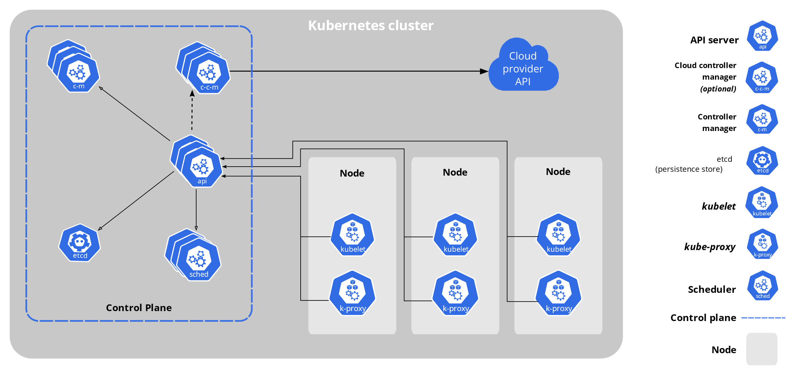
Architecture of k8s System
Notes:
Speak to the function/purpose behind each component in diagram and talk through steps that take place in a cluster when we run kubectl apply (e.g., to apply a service and a deployment to the cluster)

Slide 115
Core Components of k8s
When you deploy Kubernetes, you get a cluster.
A Kubernetes cluster consists of a set of worker machines, called nodes, that run containerized applications. Every cluster has at least one worker node.
The worker node(s) host the Pods that are the components of the application workload.
The control plane manages the worker nodes and the Pods in the cluster.

Slide 116
k8s Resource/Manifest
Kubernetes manifests are text files, usually written in YAML
They are used to create, modify and delete Kubernetes resources

Slide 117
Kubernetes Control Plane & Data Plane
Kubernetes is actually a collection of pods implementing the k8s api and the cluster orchestration logic (AKA the Kubernetes control plane)
The application/data plane is everything else, meaning all the nodes that host all the pods that the application runs on
The controllers of the control plane implement control loops that repeatedly compare the desired state of the cluster to its actual state
When the state of the cluster changes, controllers take action to bring it back inline with desired state

Slide 118
Declarative and Desired State
Kubernetes supports a declarative model – we can send the api a yaml file in a declarative form
Desired state means that we specify in the yaml file our desired state and the cluster takes responsibility to make sure it will happen
We describe the desired state using a yaml or json file that serves as a record of intent, but we do not specify how to get there (this is kubernetes responsibility to get us there)
Things could change or go wrong over the lifetime of the cluster (node failing, etc…), Kubernetes is responsible to always make sure that the desired state is kept intact
Kubernetes control plane controllers are always running in a loop and checking that the actual state of the cluster matches the desired state, so that if any error occurs they kick in and rectify the cluster

Slide 119
Reconciling state
Watch for the spec fields in the YAML files
The spec describes what we want the thing to be
Kubernetes will reconcile the current state with the spec (technically, this is done by a number of controllers)
When we want to change a resource, we update the spec, and reapply
Kubernetes will then converge that resource

Slide 120
k8s Pods: The Basic Building Block
A pod represents a set of running containers in your cluster
Worker nodes host pods
The control plane manages the worker nodes and the pods inside them
Notes:
Talk about how pod provides layer of abstraction over top of compute (does not require that k8s knows intimate details about Docker)

Slide 121
k8s Pods: The Basic Building Block
Pod is the basic execution and scaling unit in Kubernetes
Kubernetes runs containers but always inside pods
It is like a sandbox in which containers run (abstraction)
A pod groups containers for execution together on same node, sharing resources (RAM, CPU, network, volumes, etc.)

Slide 122
Pod state
Pods are considered to be relatively ephemeral (rather than durable) entities
Pods do not hold state, so if a pod crashes, Kubernetes will replace it with another
Multiple instances of the same pod are called replicas

Slide 123
Deployments
A Deployment controller provides declarative updates for Pods and ReplicaSets
The Deployment Object gives us a better way of handling the scaling of pods
The advantage of using Deployment versus using a replicaset is having rolling updates support for the pod container versions out-of-the-box

Slide 124
Deployments
Every time the application code changes, a new version of the application container is built, and then there is a need to update the Deployment manifest with the new version and tell K8s to apply the changes
K8s will then handle the rolling-out of this newer version, terminating pods with the old version as it spins up the new pods with the updated container
This means that at some point we will have multiple versions of the same application running at the same time

Slide 125
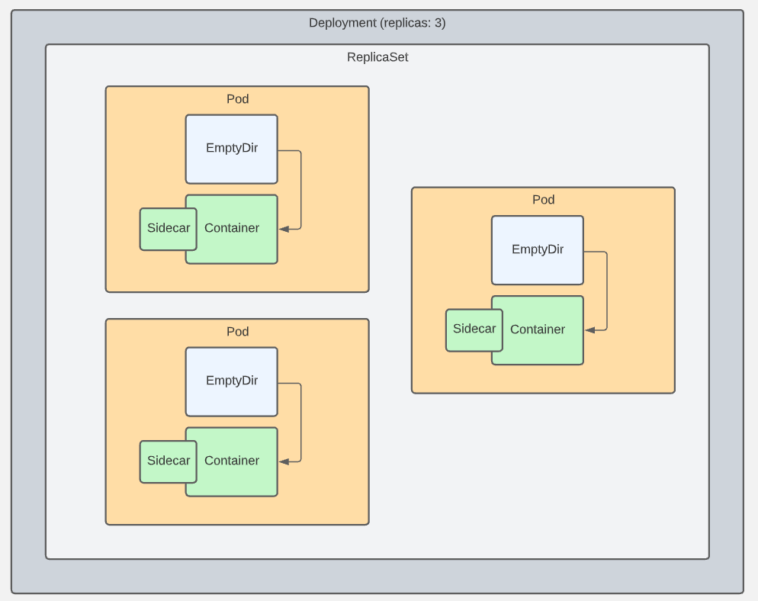
Pods, Deployments, & ReplicaSets

Slide 126
LAB:
Execute the lab available at https://github.com/KernelGamut32/capital_group_edge_la_public/tree/main/labs/week02/k8s-deployments.
Kubernetes – Deployments

Slide 127
Question for the Group
This component is used in a Kubernetes cluster to store state about the cluster and the resources it is responsible for:
API server
Scheduler
etcd
Controllers
Type your choice in the chat…

Slide 128
Question for the Group
This component is used in a Kubernetes cluster to monitor current state against desired state, and notify the cluster when an update is required to resolve any gaps:
API server
Scheduler
etcd
Controllers
Type your choice in the chat…

Slide 129
Question for the Group
This component provides the programmatic interface to the Kubernetes cluster and is used by other components and users for retrieving data about the cluster and applying changes to the cluster:
API server
Scheduler
etcd
Controllers
Type your choice in the chat…

Slide 130
Addons: Cluster DNS
A DNS system that runs in a pod in your cluster
It also spins up a k8s Service
Allows the use of consistent DNS names instead of IP addresses

Slide 131

k8s Probes
The pods in a node are not always up and running, ready for incoming traffic
We need a way to check
The kubelet does this through periodic “liveness” checks into the pods in its node

Slide 132
kubectl
kubectl (“kube-cuttle”) is command-line tool used to interact with API
May require installation (automatic if using k8s via Docker Desktop)
Config file defines details of connection to cluster (e.g., ~/.kube/config)
Run `kubectl cluster-info` to confirm connectivity
Run `kubectl` from command-line (with arguments) to see options
NOTE: k8s in Docker Desktop should handle most of this for you

Slide 133

Namespaces in k8s
Provide a grouping mechanism in Kubernetes
Every k8s object belongs to a namespace
Every Cluster automatically includes a default namespace

Slide 134
Namespaces in k8s
Allow you create logical separation within a physical Cluster
Provide a boundary for security and resource control
Can explicitly create a namespace and deploy resources to it using namespace field in manifest or --namespace arg on kubectl
Notes:
Could be used to separate by environment, by dev, by test area, or whatever

Slide 135
Namespaces in k8s
Objects within a namespace are isolated from others
Enables creation of multiple instances of same apps with same names
Resources from one namespace can communicate with another namespace using Services
Controller only looks for matching resources in its namespace

Slide 136
Contexts
Can be used to define connection details for a k8s Cluster
Sets the default namespace to be used
Prevents need to specify namespace – will use context to automatically set if excluded (like with default in standard install)
Able to switch between contexts using use-context command

Slide 137
Contexts
Can also be used to manage switching between different Clusters (local or remote)
For remote, API server will be secured with TLS and kubectl uses a client cert for AuthN

Slide 138
LAB:
Execute the lab available at https://github.com/KernelGamut32/capital_group_edge_la_public/tree/main/labs/week02/k8s-namespaces.
Kubernetes – Namespaces

Slide 139

ConfigMaps vs. Environment Variables
A ConfigMap is an API object that lets you store configuration for other objects to use
These are key/value pairs
This lets you decouple environment-specific config data from your container images, making your apps more portable
CAUTION: ConfigMaps do not provide encryption or secrecy. Use a Kubernetes Secret for that.

Slide 140
ConfigMaps
Can be:
Set of key-value pairs
Blurb of text
Binary files
One pod can use many ConfigMaps and one ConfigMap can be used by many pods
Data is read-only – pod can’t alter

Slide 141
ConfigMaps as Env Vars
Can be created from a literal:
`kubectl create configmap <name> --from-literal=<key>=<value>`
Can be created from a file (to group together multiple settings):
`kubectl create configmap <name> --from-env-file=<file-path>`
Where <file-path> contains .env file like:
key1=value1
key2=value2
Can be created from a .yml definition file (like all things k8s)

Slide 142
ConfigMaps
Can be presented as files inside directories in the container
Uses volumes – making contents of ConfigMap available to pod
Uses volume mounts – loads contents of ConfigMap volume into specific container path in pod
Can contain settings to override defaults

Slide 143
ConfigMaps - Precedence
If env vars defined in multiple places, definitions in `env` section in pod spec will trump others (localized)
Typical approach:
Default app settings “baked in” to container image (e.g., to support dev mode)
Specific settings for an environment stored in ConfigMap and surfaced to container filesystem
Merges with default settings (overwriting where applicable)
Final tweaks can be accomplished with env variables in pod spec

Slide 144

Secrets in Pods
Secrets let you store and manage sensitive information, such as passwords, OAuth tokens, and ssh keys.
A pod needs to reference a secret. There are three ways get to the secret:
As a file in a Volume that is mounted to a container;
As an environment variable for a container;
By the kubelet, when it pulls images for the pod
NOTE: The default config for a Secret does NOT have encryption – data is plain text. You need to configure “Encryption at Rest” for the Secret”, and Role Based Access Control in your cluster

Slide 145
LAB:
Execute the lab available at https://github.com/KernelGamut32/capital_group_edge_la_public/tree/main/labs/week02/k8s-cms-and-secrets.
Kubernetes – ConfigMaps & Secrets

Slide 146
DEMO:
Kubernetes – ConfigMaps & Secrets
Notes:
If time permits, execute demo at https://github.com/KernelGamut32/working-with-k8s-public/tree/main/labs/lab05

Slide 147

k8s Services
Services are an abstraction
They define a set of pods, and an access policy for them
A pod has an IP address
Pods are ephemeral – what happens to IP traffic if they die?
Pods in a service can have fixed IP addresses that stay the same even if the actual pod dies and is spun up again
Services are k8s objects; they are created like any other

Slide 148
k8s Service Types
ClusterIP (default): IP is internal to the cluster
NodePort: IP for the port is exposed with a static IP address
LoadBalancer: IP traffic to nodes is managed by external load balancer
ExternalName: IP traffic is routed by DNS Name (foo.example.com)

Slide 149
Cluster Access – Internal vs. External
You can access the cluster API using kubectl (“proxy”)
You can get libraries for popular languages that can access the cluster
k8s objects (pods) can also access the API internally
This uses an internal DNS
“kubernetes.default.svc” maps to the API server
The pod usually uses a “sidecar” container to do this

Slide 150
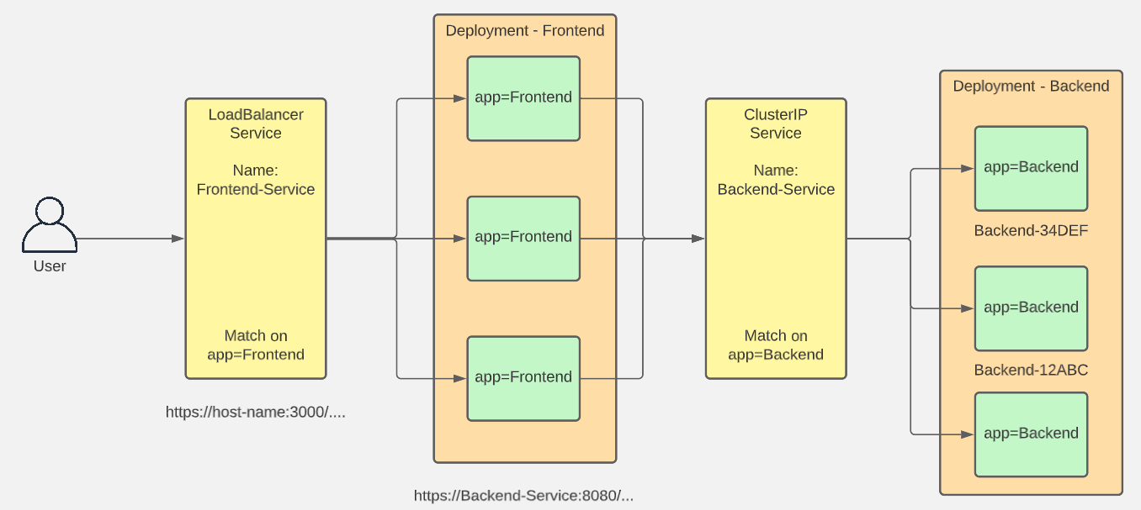
Services

Slide 151
LAB:
Execute the lab available at https://github.com/KernelGamut32/capital_group_edge_la_public/tree/main/labs/week02/k8s-services.
Kubernetes – Services

Slide 152

Container File System
Each container in a pod has its own filesystem built by k8s
Can be built from multiple sources, including:
Layers from the container image
Writable layer for the container
Can be expanded with other sources like ConfigMaps and Secrets – mounted to a specific path in a container
Volumes can provide another source of storage – volumes are defined and mounted to containers

Slide 153
EmptyDir
Empty directory stored at pod level vs. container level
Mounted as a volume into the container so visible there
Any data stored there from the container remains in pod between restarts
Replacement containers can access data from predecessors

Slide 154
HostPath
Data physically stored on node in cluster
Extends beyond lifecycle of pod
Available to replacement pods (but only if run on same node)
Mounted as a volume into the container like others
However, can have issues:
In cluster with multiple nodes, limits usefulness
If not careful, can expose large blocks of host data

Slide 155
PersistentVolume
Like pods (abstraction over computer) and services (abstraction over network), persistent volumes provide abstraction over storage
k8s object that defines available section of storage
Can be “mapped” to shared storage (like NFS) or locally (for dev/test purposes)

Slide 156
PersistentVolumeClaim
Pods are not allowed to use persistent volumes directly
Instead, pods claim using PersistentVolumeClaim object type in k8s
Requests storage for a pod
k8s handles matching up a claim to a persistent volume
Provides virtual storage abstracted from actual storage

Slide 157
Dynamic Provisioning
Static provisioning accomplished by explicitly creating persistent volume and then claim (k8s binds claim to volume)
Dynamic provisioning supported as well
You create the persistent volume claim and let persistent volume be created on demand by cluster
Can leverage storage classes for defining and matching types of storage

Slide 158
Storage Classes
Defined by three properties:
provisioner – component that creates persistent volumes on demand
reclaimPolicy – what to do with dynamically created volumes when claim is deleted
volumeBindingMode – eager vs. lazy binding/creation (at same time as claim creation or only when pod using the claim get created)
Also, able to create custom storage classes defined by same properties

Slide 159
LAB:
Execute the lab available at https://github.com/KernelGamut32/capital_group_edge_la_public/tree/main/labs/week02/k8s-pvs-and-pvcs.
Kubernetes – Persistent Volumes & Persistent Volume Claims

Slide 160
Filler
If time still left, consider doing the following to wrap up:
Have the associates discuss in groups: (PREFERRED OPTION)
Key learnings coming out of the week
Identify 3 – 5 ways that you could potentially apply the material you’ve been learning about this week in your teams and/or in your day-to-day

Slide 161




Thank you!
If you have additional questions, please reach out to me at:
erik-gross@pluralsight.com

